Slide 1
Halide
A Language for Fast, Portable Computation on Images and Tensors
Speaker: Alex Reinking
Notes:
Hi everyone…
---
[t = 0 min – remember to reset]
[slides 1 – 7 = 5 min]

Slide 2
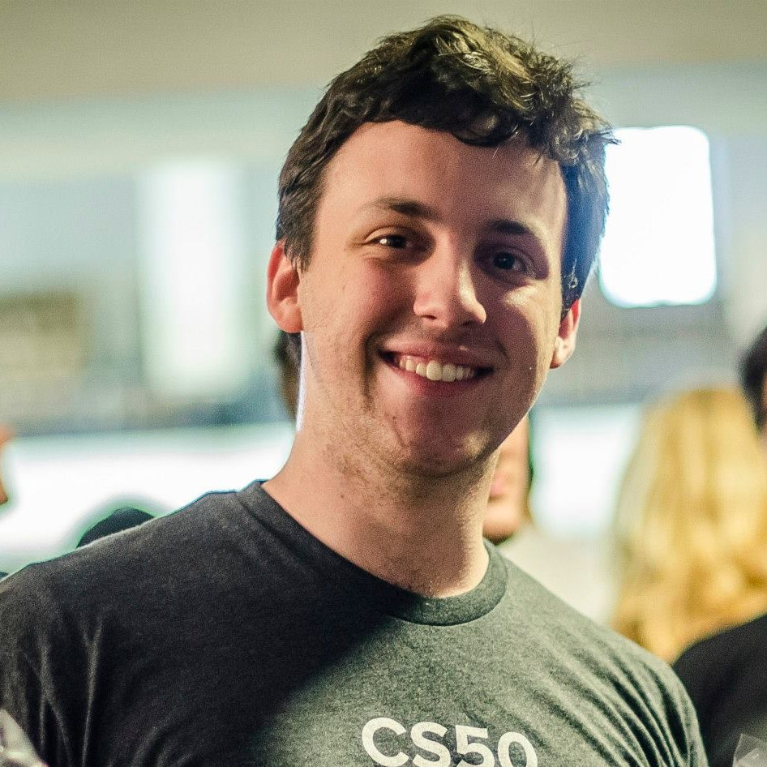
Alex Reinking
First CppCon talk!
Programming languages researcher
Domain-specific design for high performance languages
Notes:
Thank you all for coming!
I’m Alex Reinking and I’m very excited and honored to be presenting at my very first CppCon! If we haven’t already met in the Hallway Track, you might be wondering who I am and what I do. Well, I’m a programming languages and compilers researcher at UC Berkeley. I’m still working on my PhD, and in a nutshell, I design and analyze domain-specific languages (or DSLs) with high performance in mind.

Slide 3
Domain-Specific Languages
A DSL is a language that is specialized and restricted to meet the needs of some domain.
Goals: faster performance, easier maintenance, safety guarantees, etc.
Internal: Eigen3, Boost.Spirit, Boost.Proto
External: CMake, Bison, SQL, Regex (ish)
Notes:
So if you aren’t sure what I mean by that, just know DSLs are programming languages that are specialized and restricted to best meet the needs of a particular domain. The goal of a DSL is to exploit those restrictions to give programmers faster performance, easier maintenance, safety guarantees, and so on. Importantly, DSLs won’t let you write just anything. I don’t think you can write a web server in CMake, and if by chance you can, then you probably shouldn’t. Instead, DSLs really focus on making some part of a larger software system easier to handle. It’s nicer and more portable to write CMake than raw shell scripts and batch files. It’s also more efficient to use a well-engineered parser generator than to read a bunch of textbooks and write down parsing tables yourself.
In the programming languages world, we draw a distinction between internal DSLs that borrow the host language’s syntax and toolchain and external DSLs that supply their own. But in either case, you’ve probably used a few. Eigen3 and Boost.Spirit are popular C++ internal DSLs for linear algebra and writing parsers, respectively. And then Cmake, Makefiles, Bison, SQL, and even Regex are external DSLs most of us have encountered at some point or another.

Slide 4
Halide
DSL staged in C++: “just” a library
Helps you write high-performance array, image, and tensor processing kernels
Separate algorithm from optimization.
Open source, MIT licensed.
Notes:
That brings us to Halide, which is the subject of this talk. So Halide is a hybrid of the internal and external DSL approaches. It’s embedded in C++ so in that sense it’s “just” a library like Eigen is. But on the other hand, it executes code by JITting or by producing C-ABI compatible object files, so in that sense it’s more external.
The problem it helps you solve is optimizing dense numerical kernels like those found in image processing, computer vision, machine learning, and AI. It does this through a powerful application of separation of concerns. In Halide, you define what you want to compute separately from how you want to optimize it.

Slide 5



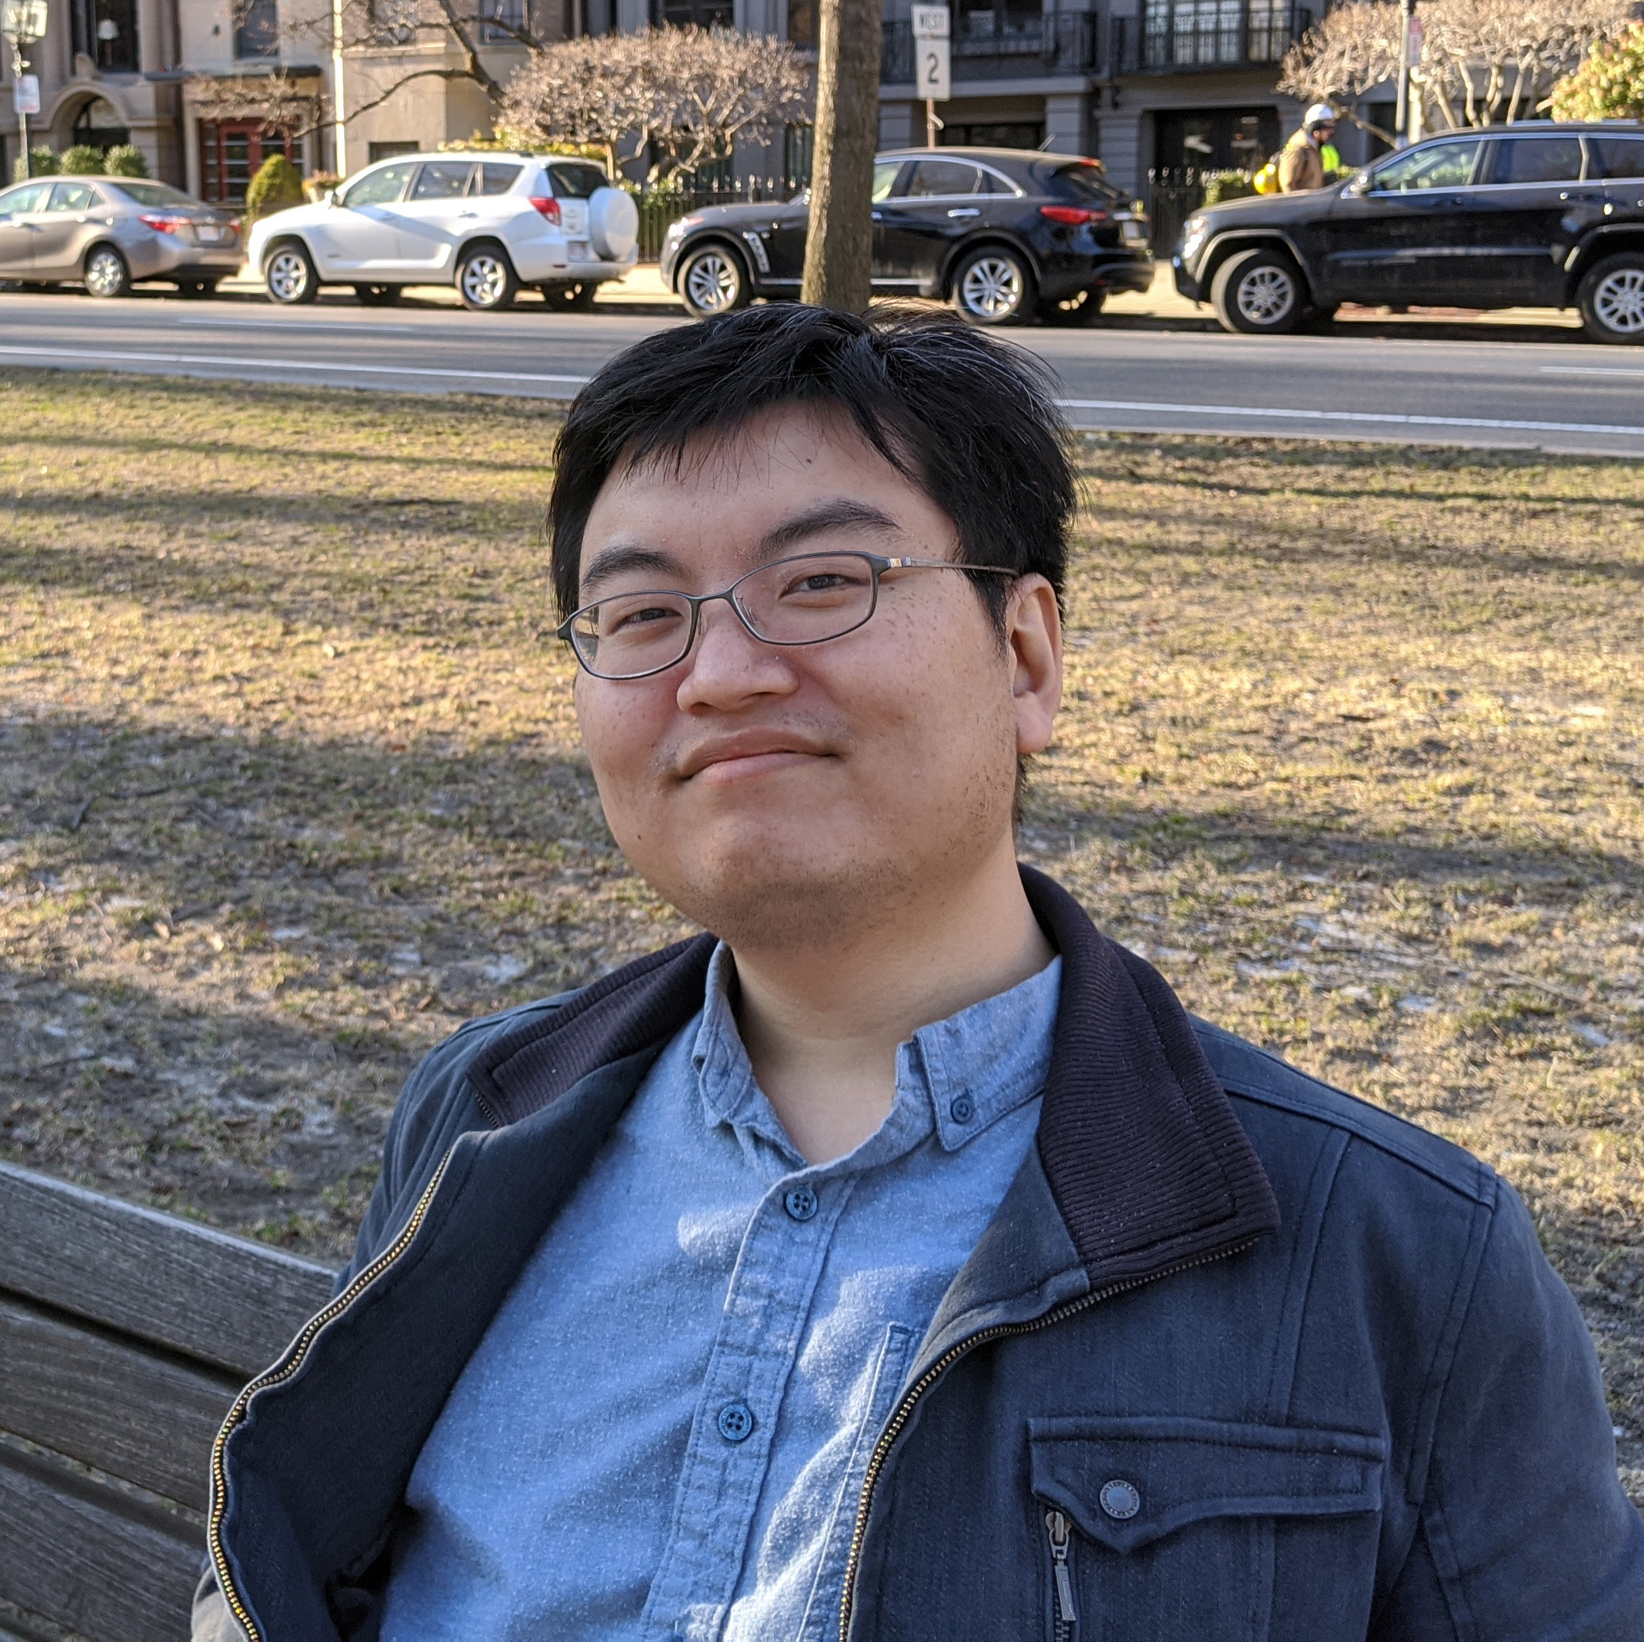


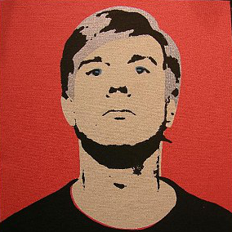

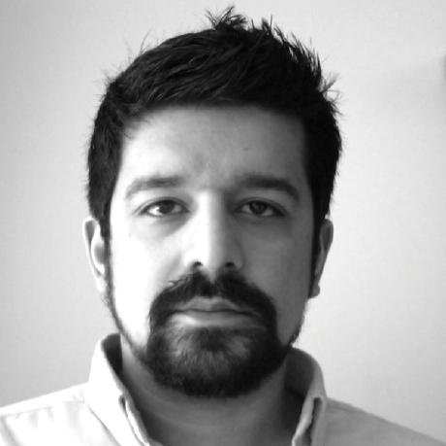

Jonathan
Ragan-Kelley
Andrew Adams
Steven
Johnson
Tzu-Mao
Li
Alex Reinking
Volodymyr Kysenko
Benoit Steiner
Dillon
Sharlet
Shoaib
Kamil
Zalman
Stern
And many more!
Notes:
Now, before I accidentally take all the credit, I want to acknowledge the incredible open source team backing Halide. My adviser Jonathan, and my colleague Andrew created Halide in 2011 while they were at MIT. My own personal role in the team is twofold: first, as part of my PhD research I am working on publishing a mathematical proof that Halide programs will never crash and that its optimizations are safe. And then second, I work on the build system, testing, continuous integration, and the release cycle.

Slide 6



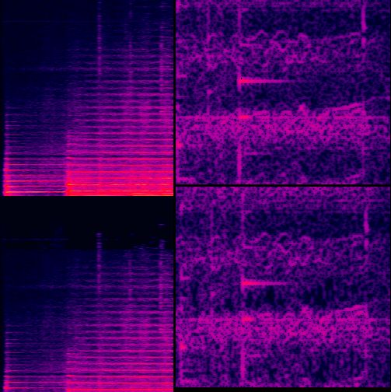
Google Pixel Camera
(pc: Mauricio Pesce CC BY 2.0)
Adobe Photoshop Layer Compositing
D.w. sep. convolution faster than TensorFlow
Fourier Transform faster than FFTW
Notes:
I also want to emphasize that this isn’t a talk about some new or unproven technology. The amazing people I work with have made Halide into the system of choice for the Google Pixel camera and the Adobe Photoshop layer compositor. When you snap a photo on a Pixel phone or edit a Photoshop document, you’re using Halide. We have implemented faster neural network layers than TensorFlow, faster blurs than OpenCV, faster matrix multiplies than Eigen, and a faster Fourier Transform than FFTW (which styles itself the Fastest Fourier Transform in the West). In fact, because YouTube uses Halide at scale to re-encode video, when this talk and all the other CppCon talks get uploaded, they will be processed by Halide.
---
Google Pixel smartphone photo: https://commons.wikimedia.org/wiki/File:Google_Pixel_and_Pixel_XL_smartphones_(30120254046).jpg
Photoshop icon public domain: https://commons.wikimedia.org/wiki/File:Adobe_Photoshop_CS3_icon.png
Spectrogram public domain: https://commons.wikimedia.org/wiki/File:MP3_192kbps_vs_PCM.png
Deep learning picture public domain: https://commons.wikimedia.org/wiki/File:Deep_learning.png

Slide 7
Agenda
Yes: Challenges in fast array processing
Yes: How Halide works as a language
Yes: How Halide works as a C++ library
No: assembly or microarchitecture
No: in-depth tutorial
Notes:
So with that out of the way, let me briefly summarize the rest of the talk. We’re going to discuss the main challenges in fast array processing, what matters for performance, what trade-offs we make, and how Halide helps you optimize for those factors. Then we’re going to talk a bit about Halide’s architecture and how it integrates into your programs and builds. But we’re not going to be diving deep into architecture-specific details or picking apart assembly sequences. We’re also not going to cover every feature in Halide. We only have an hour, so I want you to take something away from this talk that applies outside of Halide, too. There will also be a few times when I will pause for questions. Please don’t hesitate to ask!

Slide 8
Understanding performance
CPUs are incredibly complex alone
Multi-level caches
Vector instructions
Multiple cores / SMT
Superscalar and out-of-order execution
…
Heterogeneous: using GPUs and DSPs?
Counterintuitive more often than not
Notes:
Now, without even thinking about GPUs and digital signal processors and other specialized accelerator hardware, I want you to think about your CPU. It is incredibly complex.
To optimize your programs for it, you have to reason about multi-level caches, vector instructions, multiple cores and the costs and benefits of hyperthreading; you have to think about superscalar and out-of-order execution, branch prediction and the list goes on.
If you do throw a co-processor into the mix, then you have to think not only about how to optimize the code that runs on the other device, taking into account all of its architectural details, but you also have to think about how to optimize the communication between it and the CPU. And if there’s anything we know to be true in computer science it’s that programmers – even experts, even me – are notoriously bad at predicting performance. Half the time our optimization attempts do nothing and the other half they make things worse.
---
[t = 5 min]
[slides 8 – 21 = 5 min – pace yourself!]

Slide 9
Parallelism
Independent tasks
Notes:
Still there are some go-to strategies we can look at. So imagine that each one of these squares is some unit of work that your program has to do. One of the simplest optimizations is to divide independent work…

Slide 10
Parallelism
Independent cores
Notes:
…among independent CPU cores. Of course, you need to have opportunities for this in the first place, and there are issues with hidden dependencies, like false sharing, but by and large, if you add processors to a problem with enough independent work to keep them busy, you should expect a proportional speedup.

Slide 11
Redundant work
Loading a value from memory sometimes slower than re-computing it
This is especially true when vectorizing.
1
Notes:
Another optimization that might be less intuitive is to recompute values instead of loading them from memory. Remember that each level of cache is slower than the last until you hit DRAM (or main memory). So if your values aren’t cached, it can be a net win to do some extra work. This is an old idea, going back to rematerialization in register allocators in the 1970s, but it’s still very relevant to today’s vector instruction sets.
So suppose you’re modifying some array using vectors of width 4. If the array’s length isn’t an even multiple of four, like this one, which has 14 elements, then you’ll step one…

Slide 12
Redundant work
Loading a value from memory sometimes slower than re-computing it
This is especially true when vectorizing.
1
2
Notes:
Two…

Slide 13
Redundant work
Loading a value from memory sometimes slower than re-computing it
This is especially true when vectorizing.
1
2
3
Notes:
Three… vectors out

Slide 14
Redundant work
Loading a value from memory sometimes slower than re-computing it
This is especially true when vectorizing.
4?
5?
1
2
3
4
Notes:
Before reaching the end. Now, with only two squares left you can either shift inwards and recompute a small amount of overlap (shown here in bright yellow), with a single vector instruction.
OR you can switch to serial code and execute two… slower… instructions in a different code path. Most of the time, we’ll prefer the former because the inwards shift can be computed without branches or bloating the code size.

Slide 15
Locality
If you just wrote a value to memory, you should try to use it quickly, while it’s still in cache.
Step 1
Step 2
Notes:
Finally, we get to the last big optimization opportunity: cache locality. Suppose you have two stages of work, where the tasks are independent in each stage, but there are some dependencies between the tasks as shown by the arrows here. We could go breadth first and compute all…
…of the values in step 1 before any of the values in step 2, committing those all to memory in between…

Slide 16
Locality
If you just wrote a value to memory, you should try to use it quickly, while it’s still in cache.
Step 1
Step 2
Locality is a function of reuse distance
Notes:
…or we could interleave the computations of step 1 and step 2, and then the memory written by step 1 will still be fresh in the cache when it’s read in step 2.
Ultimately, locality is a function of reuse distance. We want to reuse values as quickly as possible to optimize for the cache.
On the other hand, it isn’t obvious how you can parallelize this fused, two-step process. That interleaving looks really hopeless from a parallelization perspective. We can’t just “pragma omp parallel for” our way to victory here.

Slide 17
Trading off
Step 1
Step 2
Notes:
Instead, what we can do is break the dependency chain…

Slide 18
Trading off
Step 1
Step 1
Step 2
Step 2
CPU 1
CPU 2
Notes:
…by introducing some redundant work. The red squares here mark where work was duplicated from the other side.
And we can continue to break this problem down by introducing only a small amount of redundant overhead per thread we want to use.

Slide 19
Trading off
Redundancy
Locality
Parallelism
Notes:
This then gives us the best of all three worlds. We can keep multiple CPUs busy, each one accessing its caches in a nice, local way, and we didn’t have to introduce very much redundant work to do it.
Trading off between locality, parallelism, and redundant computation is at the heart of optimizing any numeric pipeline. The general principle is to strive for locality within threads and introduce redundant work strategically to break dependencies. It’s a delicate balancing act with no simple heuristics, but it’s the one that Halide helps you perform.

Slide 20
Why not use libraries?
Optimized kernels compose into inefficient pipelines.
Even MKL, OpenCV, etc.
DRAM
DRAM
DRAM
Step 1
Step 2
Step 3
…
Notes:
So you might be thinking: “this is great knowledge for library writers, but application developers can still get great performance by composing routines from highly optimized libraries like Intel’s Math Kernel Library or OpenCV, right?”
Well… the short answer is “no” because there’s no way to fuse across the stages of computation. Every time you finish calling a function, you sync all your data back to RAM before calling the next one. This is slow for the same reason we just saw with the locality example. There’s no way to rearrange the computation between the stages and get small reuse distances. Optimized kernels compose into inefficient pipelines in general.

Slide 21
Why not “–O4”?
Optimizations can disable better ones. Need manual exploration.
Important optimizations not legal in C++.
Global reorganization of computation
C++ is Turing-complete. DSLs are not.
Notes:
Okay, so why not make C++ compilers do this work for us? There are a few good reasons.
The first is that the space of possible optimizations is extraordinarily large and complex. Making one decision that looks good locally might make the optimizer miss a much better opportunity down the line. Experts optimizing code by hand try countless alternatives before landing on the one that works the best.
Second, some important optimizations are not legal in C++. Compilers aren’t allowed to simply change your malloc sizes or reorder calls to external functions, they have to obey the rules of the language.
The most beneficial optimizations are those that carefully fuse many stages of computation together; C++ compilers are not typically able to discover these sorts of global reorganizations on their own.
And finally, from a theoretical standpoint, C++ is rightly Turing-complete. That means that C++ can do absolutely anything. By contrast, all Halide can do is express feed-forward array programs. That makes it much easier to analyze.

Slide 22
Running example
Notes:
So for the rest of this talk, we’re going to use to this running example that sort of typifies the kind of program Halide helps you optimize.
---
[t = 10 min]
[slides 22 – 35 = 5 min – pace yourself!]

Slide 23

Two-Stage Blur
input
Notes:
It’s called the two-stage blur and it’s a particular instance of the abstract example we saw earlier. As the name suggests, it’s going to take an input image and make it blurry. No surprises there. But what might be a bit unconventional is that it’s going to first…

Slide 24

Two-Stage Blur
input
horizontal blur
Blur by averaging pixel values in a $1×3$ window
Notes:
…blur horizontally. In code, we blur a pixel by computing an average of the pixels around it. In this first step, we compute the horizonal blur by averaging a pixel with its neighbors to the left and right. That gives us this intermediate step here. Then…

Slide 25

Two-Stage Blur
input
horizontal blur
vertical blur
Blur by averaging pixel values in a $3×1$ window
Overall blur averages a $3×3$ window of the input
Notes:
…we do the same thing on the horizontally blurred image, but vertically. So now we average the neighbors above and below the final pixel. In the end, this is effectively the same as blurring the full three-by-three box around a pixel in one giant step but splitting it up into two steps does less arithmetic overall.

Slide 26
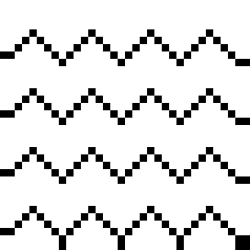
Two-Stage Blur
input
extend boundary
horizontal blur
vertical blur
To avoid shrinking the image, repeat the edge
Notes:
Now, as with all things in computer science, there are edge cases. But in image processing, they’re very literal. If you’re trying to blur the pixels around the edge of the image, you’ll find that some values are missing. You could skip those pixels, but it would crop a 1-pixel border off the image. We don’t want that to happen, so we just extend the boundary by repeating the outer edge to keep the image size the same.

Slide 27
template<typename T> struct Image<T> { Image(int w, int h); int width(); int height(); T& operator()(int x, int y); private: std::vector<T> data; int w; int h; }
C++
input
extend boundary
horizontal blur
vertical blur
Notes:
So let’s try to write this in C++. Imagine we’ve already got a struct called Image that wraps a std::vector and exposes a two-dimensional operator parens to access its elements according to the width and height. This is definitely slide code and I don’t want to dwell too much on it. Just assume that the Image struct does the right thing.

Slide 28
C++
const Image<uint8_t> &in
input
Image<uint16_t> in16(in.width() + 2, in.height() + 2); for (int x = 0; x < in16.width(); ++x) for (int y = 0; y < in16.height(); ++y) in16(x, y)=in(clamp(x,0,in.width()-1),clamp(y,0,in.height()-1));
extend boundary
Image<uint16_t> blur_x(in16.width()-2, in16.height()); for (int x = 1; x <= blur_x.width(); ++x) for (int y = 0; y < blur_x.height(); ++y) blur_x(x–1, y) = (in16(x–1,y) + in16(x,y) + in16(x+1,y))/3;
horizontal blur
Image<uint8_t> blur_y(blur_x.width(), blur_x.height()-2); for (int x = 0; x < blur_y.width(); ++x) for (int y = 1; y <= blur_y.height(); ++y) blur_y(x, y–1) = (blur_x(x,y–1) + blur_x(x,y) + blur_x(x,y+1))/3;
vertical blur
Notes:
The input will be represented by a const reference to such an image struct.
Then we can get started with the boundary extending step. We create an intermediate image that’s got extra space for the border. We make it uint16 instead of uint8 because we don’t want the addition in the averages to overflow later. Then we loop over all the uninitialized points in the padded image and assign them to the closest values from the input. C++17 makes that easy since it adds the clamp algorithm we use here. Clamp simply compares the first value to the next two arguments, which are a lower and an upper bound. If it’s less than the lower bound, it returns the lower bound and if the value is greater than the upper bound, then it uses the upper bound instead. It’s a super useful algorithm for ensuring you don’t read out of bounds.
Then in the horizontal blur step, we create another intermediate image, this time a bit narrower than the padded image to account for the shrinking boundary. We loop over all the points again and average the neighbors like I explained before. Pay careful attention to the loop bounds. We iterate from x=1 to x equals the width of the image since we’re always writing to “x-1” in the body of the loop.
Finally, we do the same sort of pattern for the vertical blur.

Slide 29
C++
const Image<uint8_t> &in
Image<uint8_t> blur( ) { return blur_y; }
input
Image<uint16_t> in16(in.width() + 2, in.height() + 2); for (int x = 0; x < in16.width(); ++x) for (int y = 0; y < in16.height(); ++y) in16(x, y)=in(clamp(x,0,in.width()-1),clamp(y,0,in.height()-1));
Image<uint16_t> blur_x(in16.width()-2, in16.height()); for (int x = 1; x <= blur_x.width(); ++x) for (int y = 0; y < blur_x.height(); ++y) blur_x(x–1, y) = (in16(x–1,y) + in16(x,y) + in16(x+1,y))/3;
extend boundary
Image<uint8_t> blur_y(blur_x.width(), blur_x.height()-2); for (int x = 0; x < blur_y.width(); ++x) for (int y = 1; y <= blur_y.height(); ++y) blur_y(x, y–1) = (blur_x(x,y–1) + blur_x(x,y) + blur_x(x,y+1))/3;
horizontal blur
Fast, right?
vertical blur
Notes:
And then it really isn’t too much trouble to glue this together. I’ll give you a second to take it all in.
Now, we’re writing C++ so this should be fast, right? We take the input by reference so no copy there, we get NRVO for the result, so no copy there either. We’ve got loops that can probably be automatically vectorized. The stars should align for us.

Slide 30
Performance analysis
C++
Image<uint16_t> blur_x(in16.width()-2, in16.height()); for (int x = 1; x <= blur_x.width(); ++x) for (int y = 0; y < blur_x.height(); ++y) blur_x(x–1, y) = (in16(x–1,y) + in16(x,y) + in16(x+1,y))/3;
If images are row-major, this will write to a different cache line on every iteration
Benchmark on 4-megapixel image. Run on Intel i9-7900X, 32 GB RAM
100ms… ouch!
Notes:
But it isn’t so simple. If the Image struct uses a row-major memory layout, so that adding one to “x” adds one to the pointer into blur_x, this code will write a pixel value to a different cache line on every iteration. This is about the worst performance you can get on this example without going out of your way to do something weird.
On my machine, running this on a 4-megapixel image takes about 100 milliseconds. Not very fast at all.

Slide 31

Swap the loops!
C++
Image<uint16_t> blur_x(in16.width()-2, in16.height()); for (int x = 1; x <= blur_x.width(); ++x) for (int y = 0; y < blur_x.height(); ++y) blur_x(x–1, y) = (in16(x–1,y) + in16(x,y) + in16(x+1,y))/3;
Poor locality
Image<uint16_t> blur_x(in16.width()-2, in16.height()); for (int y = 0; y < blur_x.height(); ++y) for (int x = 1; x <= blur_x.width(); ++x) blur_x(x–1, y) = (in16(x–1,y) + in16(x,y) + in16(x+1,y))/3;
Better locality
Notes:
Fortunately, there’s a simple fix. Just swap the loops. You don’t need to make any changes to the assignment since all the loop iterations are independent. Now you’ll access consecutive cache lines which is much better for the CPU. If you do this, then it drops to 8ms on the same image, a 12-13x speedup. A full order of magnitude! If you imagine memory being laid out left to right and top to bottom, then you can clearly see the issue with the traversal order. This is one of the few times you can tell something will be slow at a glance since it never accesses memory in a nice, local way.

Slide 32
Optimized C++
void box_filter_3x3(const Image &in, Image &blury) {
__m128i one_third = _mm_set1_epi16(21846);
__m128i a, b, c, sum, avg;
__m128i *blurxPtr = blurx;
a = _mm_loadu_si128((__m128i*)(inPtr-1));
b = _mm_loadu_si128((__m128i*)(inPtr+1));
c = _mm_load_si128((__m128i*)(inPtr));
_mm_store_si128(blurxPtr++, avg);
inPtr += 8; }}
blurxPtr = blurx;
a = _mm_load_si128(blurxPtr+(2*256)/8);
b = _mm_load_si128(blurxPtr+256/8);
c = _mm_load_si128(blurxPtr++);
_mm_store_si128(outPtr++, avg); }}}}}
#pragma omp parallel for
for (int yTile = 0; yTile < in.height(); yTile += 32) {
__m128i blurx[(256/8)*(32+2)]; // allocate tile blurx array
for (int xTile = 0; xTile < in.width(); xTile += 256) {
for (int y = -1; y < 32+1; y++) {
const uint16_t *inPtr = &(in[yTile+y][xTile]);
for (int x = 0; x < 256; x += 8) {
sum = _mm_add_epi16(_mm_add_epi16(a, b), c);
avg = _mm_mulhi_epi16(sum, one_third);
for (int y = 0; y < 32; y++) {
__m128i *outPtr = (__m128i *)(&(blury[yTile+y][xTile]));
for (int x = 0; x < 256; x += 8) {
sum = _mm_add_epi16(_mm_add_epi16(a, b), c);
avg = _mm_mulhi_epi16(sum, one_third);
Notes:
If you kept on optimizing, you might eventually end up with a mess that looks like this program. You’ll have to trust me that it does the same thing, but it does it with..

Slide 33
Optimized C++
void box_filter_3x3(const Image &in, Image &blury) {
__m128i one_third = _mm_set1_epi16(21846);
__m128i a, b, c, sum, avg;
__m128i *blurxPtr = blurx;
a = _mm_loadu_si128((__m128i*)(inPtr-1));
b = _mm_loadu_si128((__m128i*)(inPtr+1));
c = _mm_load_si128((__m128i*)(inPtr));
_mm_store_si128(blurxPtr++, avg);
inPtr += 8; }}
blurxPtr = blurx;
a = _mm_load_si128(blurxPtr+(2*256)/8);
b = _mm_load_si128(blurxPtr+256/8);
c = _mm_load_si128(blurxPtr++);
_mm_store_si128(outPtr++, avg); }}}}}
#pragma omp parallel for
for (int yTile = 0; yTile < in.height(); yTile += 32) {
__m128i blurx[(256/8)*(32+2)]; // allocate tile blurx array
for (int xTile = 0; xTile < in.width(); xTile += 256) {
for (int y = -1; y < 32+1; y++) {
const uint16_t *inPtr = &(in[yTile+y][xTile]);
for (int x = 0; x < 256; x += 8) {
Parallelism across threads and SIMD vector lanes
sum = _mm_add_epi16(_mm_add_epi16(a, b), c);
avg = _mm_mulhi_epi16(sum, one_third);
for (int y = 0; y < 32; y++) {
__m128i *outPtr = (__m128i *)(&(blury[yTile+y][xTile]));
for (int x = 0; x < 256; x += 8) {
sum = _mm_add_epi16(_mm_add_epi16(a, b), c);
avg = _mm_mulhi_epi16(sum, one_third);
Notes:
parallelism from OpenMP (that’s the “pragma omp parallel for” at the top) and SSE intrinsics inside the loops.

Slide 34
Optimized C++
void box_filter_3x3(const Image &in, Image &blury) {
__m128i one_third = _mm_set1_epi16(21846);
__m128i a, b, c, sum, avg;
__m128i *blurxPtr = blurx;
a = _mm_loadu_si128((__m128i*)(inPtr-1));
b = _mm_loadu_si128((__m128i*)(inPtr+1));
c = _mm_load_si128((__m128i*)(inPtr));
_mm_store_si128(blurxPtr++, avg);
inPtr += 8; }}
blurxPtr = blurx;
a = _mm_load_si128(blurxPtr+(2*256)/8);
b = _mm_load_si128(blurxPtr+256/8);
c = _mm_load_si128(blurxPtr++);
_mm_store_si128(outPtr++, avg); }}}}}
#pragma omp parallel for
for (int yTile = 0; yTile < in.height(); yTile += 32) {
__m128i blurx[(256/8)*(32+2)]; // allocate tile blurx array
for (int xTile = 0; xTile < in.width(); xTile += 256) {
for (int y = -1; y < 32+1; y++) {
const uint16_t *inPtr = &(in[yTile+y][xTile]);
for (int x = 0; x < 256; x += 8) {
Locality in tiled computation and fusion of the two blurs
sum = _mm_add_epi16(_mm_add_epi16(a, b), c);
avg = _mm_mulhi_epi16(sum, one_third);
for (int y = 0; y < 32; y++) {
__m128i *outPtr = (__m128i *)(&(blury[yTile+y][xTile]));
for (int x = 0; x < 256; x += 8) {
sum = _mm_add_epi16(_mm_add_epi16(a, b), c);
avg = _mm_mulhi_epi16(sum, one_third);
Notes:
and it’s also locality optimized by fusing the stages together and tiling so that we can cut down on memory usage and have simpler for loop extents. But rather than pick this code apart, I want you to think about three questions.

Slide 35
Optimized C++
void box_filter_3x3(const Image &in, Image &blury) {
__m128i one_third = _mm_set1_epi16(21846);
__m128i a, b, c, sum, avg;
__m128i *blurxPtr = blurx;
a = _mm_loadu_si128((__m128i*)(inPtr-1));
b = _mm_loadu_si128((__m128i*)(inPtr+1));
c = _mm_load_si128((__m128i*)(inPtr));
_mm_store_si128(blurxPtr++, avg);
inPtr += 8; }}
blurxPtr = blurx;
a = _mm_load_si128(blurxPtr+(2*256)/8);
b = _mm_load_si128(blurxPtr+256/8);
c = _mm_load_si128(blurxPtr++);
_mm_store_si128(outPtr++, avg); }}}}}
#pragma omp parallel for
for (int yTile = 0; yTile < in.height(); yTile += 32) {
__m128i blurx[(256/8)*(32+2)]; // allocate tile blurx array
for (int xTile = 0; xTile < in.width(); xTile += 256) {
Portable?
for (int y = -1; y < 32+1; y++) {
const uint16_t *inPtr = &(in[yTile+y][xTile]);
for (int x = 0; x < 256; x += 8) {
Correct?
sum = _mm_add_epi16(_mm_add_epi16(a, b), c);
avg = _mm_mulhi_epi16(sum, one_third);
for (int y = 0; y < 32; y++) {
__m128i *outPtr = (__m128i *)(&(blury[yTile+y][xTile]));
for (int x = 0; x < 256; x += 8) {
Maintainable?
sum = _mm_add_epi16(_mm_add_epi16(a, b), c);
avg = _mm_mulhi_epi16(sum, one_third);
Notes:
First, is it portable? And I don’t mean across compilers or CPU architectures because we already know that it isn’t. It uses x86 and compiler-specific intrinsics and OpenMP, none of which are standard C++. But is it portable across different x86 CPUs with the same compiler? Also no. Different CPUs even in the same generation have different cache sizes. What’s fast on a consumer grade i5 will not be optimal for a Xeon released the same year.
Next, is it correct? How could you tell? There is actually a subtle rounding error here. Did you spot it? What would it take for you to notice and how long would it take to fix?
Finally, is this code maintainable? Based on the previous two questions, I hope you’ll agree that the answer is “no”. This code has already bit-rotted. It’s using SSE, not AVX. It has fixed tile sizes. When it was written in 2011 it was pretty good, but you shouldn’t copy it into your own program today.
---
The rounding error is with the mul/div replacement, it’s wrong for some values.

Slide 36
Algorithm
“What” to compute
Declarative specification
No explicit bounds
No loops or traversal orders
Notes:
What sets Halide apart is that it has good answers to all three of those questions. And it does it through a really clever separation of concerns. The first thing you do when writing a Halide program is define the algorithm, which specifies what to compute. It’s a declarative specification of what to do, not code that will immediately run. As such, it doesn’t care about loop bounds or memory, traversal orders, or anything else. It just serves as the single source of truth for what your pipeline should return. Later on, you’ll specify how you want to optimize it and then you get a chance to run it.
---
[t = 15 min]
[slides 36-40 = 3 min – pace yourself!]

Slide 37
Func input
input
input_16(x, y) = cast<uint16_t>( input(clamp(x, 0, input.width() - 1), clamp(y, 0, input.height() - 1));
extend boundary
horizontal blur
vertical blur
Notes:
Let’s see it in action on the blur pipeline. First, we’ll declare a “func” called “input”. A “func” in Halide is a mapping from array locations to values, but with indeterminate bounds. For the functional programmers among you, note that every func in Halide is pure. That is, it has no side-effects and always returns the same value.
So the boundary extending stage looks almost identical to what we saw earlier in C++, only it’s just the assignment statement. Again we use clamp to keep inside the bounds of the original input but remember that the input func is still a placeholder. The eventual width and height will be determined when we actually feed an image through the pipeline, not right now. Similarly, the variables “x” and “y” here are symbolic variables that don’t have specific integer values at this point.

Slide 38
Func input
input
Func clamped = BoundaryConditions::repeat_edge(input); input_16(x, y) = cast<uint16_t>(clamped(x, y));
extend boundary
blur_x(x, y) = (input_16(x – 1, y) + input_16(x, y) + input_16(x + 1, y)) / 3;
horizontal blur
blur_y(x, y) = (blur_x(x, y – 1) + blur_x(x, y) + blur_x(x, y + 1)) / 3;
vertical blur
Notes:
Repeating the edge to extend the boundary is such a common thing to do in image processing that Halide provides a helper for it. So we’ll just go ahead and use that here to make things easier to read.
Now we define funcs for the horizontal… and vertical… blurs. The horizontal one reads from the upcast image, and the vertical one reads from the horizontal image. Same as before.

Slide 39
Func blur( ) { Var x, y; Func input_16, blur_x, blur_y, result; result(x, y) = cast<uint8_t>(blur_y(x, y)); return result; }
Func input
input
Func clamped = BoundaryConditions::repeat_edge(input); input_16(x, y) = cast<uint16_t>(clamped(x, y));
extend boundary
blur_x(x, y) = (input_16(x – 1, y) + input_16(x, y) + input_16(x + 1, y)) / 3;
blur_y(x, y) = (blur_x(x, y – 1) + blur_x(x, y) + blur_x(x, y + 1)) / 3;
horizontal blur
vertical blur
Notes:
Once more, the glue code is fairly minimal. Nothing new besides the cast back down to 8-bit. Remember that since Halide is “just” a C++ library, this is valid C++ too. We’re just using operator overloading to get a natural syntax. The Func and Var types are normal C++ classes.

Slide 40
Question break
Notes:
Now is a great time to stop and answer any questions you might have because we’re about to jump in the deep end optimizing this. I’ll wait just a minute for some questions to roll in if there aren’t any and then we can move on.
[Wait up to 65 seconds for questions to come in]
[READ QUESTIONS OUT LOUD BEFORE YOU ANSWER THEM]
---
[t = 18 min]
[take at least 2 minutes for questions]

Slide 41
Schedule
“How” to compute
Declarative language for loop transforms
Guaranteed to be safe
Notes:
So the other side of the Halide coin is the schedule. The relationship between a schedule and an algorithm is pretty similar to the relationship between a CSS stylesheet and an HTML document. A schedule is a companion to the algorithm and defines an order of execution by referring to the funcs inside it. As we’ll see shortly, it controls vectorization, tiling, inlining, parallelism, and more. The scheduling language provides some strong guarantees. Applying a scheduling directive will never change your program’s output. And without manually disabling checks, your program will never crash either.
---
[t = 20 min]
[slides 41-56 = 13 min – SLLLOOOOOWWWW DOWN. You know what you’re talking about but the audience doesn’t.]

Slide 42
Scheduling
Func blur(Func input) { Var x, y; Func input_16, blur_x, blur_y, result; Func clamped = BoundaryConditions::repeat_edge(input); input_16(x, y) = cast<uint16_t>(clamped(x, y)); blur_x(x, y) = (input_16(x – 1, y) + input_16(x, y) + input_16(x + 1, y)) / 3; blur_y(x, y) = (blur_x(x, y – 1) + blur_x(x, y) + blur_x(x, y + 1)) / 3; result(x, y) = cast<uint8_t>(blur_y(x, y)); return result; }
input
extend boundary
horizontal blur
vertical blur
Notes:
So, keeping this code in mind, let’s talk about how to schedule it. And we’re going to focus in particular on the input_16, blur_x, and result funcs.
Give the audience a moment to find those funcs

Slide 43
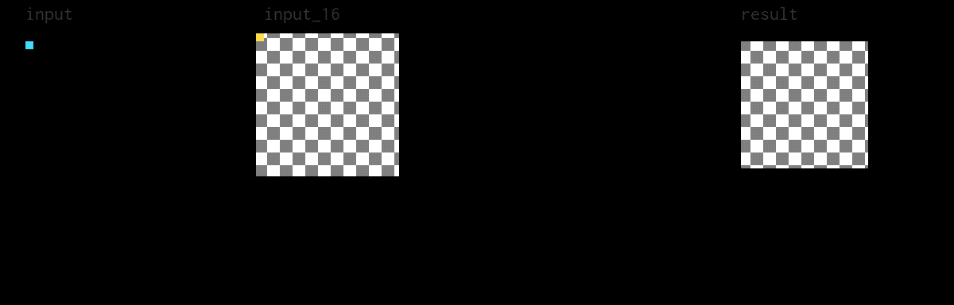
Naïve = 102ms / 1x
result.compute_root()
allocate input_16; blur_x;
.reorder(y, x);
for x:
blur_x.compute_root()
for y:
.reorder(y, x);
input_16(x, y) = ...
input_16.compute_root()
for x:
.reorder(y, x);
for y:
blur_x(x, y) = ...
for x:
for y:
result(x, y) = ...
Notes:
The next few slides are all going to follow this same format. On the bottom left, we have the Halide schedule code that’s applied to our blur algorithm. On the right is imperative pseudocode corresponding to what Halide will generate based on that schedule. On the top is a visualization of the program running on a smaller image. The checkerboard pattern indicates an uninitialized buffer, and the blue and yellow rectangles track where the pipeline is reading and writing, respectively.
This schedule is equivalent to the bad C++ code we saw earlier. It uses two directives, compute_root… and reorder… Compute_root means that Halide should compute all the values of that func and store them in a big array before anything else tries to read from it.
Then the reorder directive sets the loop order to y innermost and x outermost. We can watch the program run for a minute to see what it’s doing.
[time above so that it loops just when you start saying this]
First, we can see “input” get copied, padded, and upcast into “input_16”.
Then we can watch as wide rectangles of “input_16” are read to compute single pixels in “blur_x”.
Finally, we can watch as tall rectangles of “blur_x” are read and down-cast to compute pixels in “result”.

Slide 44

Serial = 8ms / 13x
result.compute_root()
allocate input_16; blur_x;
for y:
blur_x.compute_root()
for x:
input_16(x, y) = ...
input_16.compute_root()
for y:
for x:
blur_x(x, y) = ...
for y:
for x:
result(x, y) = ...
Notes:
Now this schedule is the same as the faster C++ code we saw earlier, with the corrected loop order. Because Halide either knows or controls the memory layout for every func, it gets traversal orders “right” by default.
Again we can watch as input gets copied and padded into input_16, but this time in a cache-friendly order.
Then we can watch input_16 get blurred horizontally.
And finally we can watch blur_x get blurred vertically, all using the straightforward memory access pattern.

Slide 45
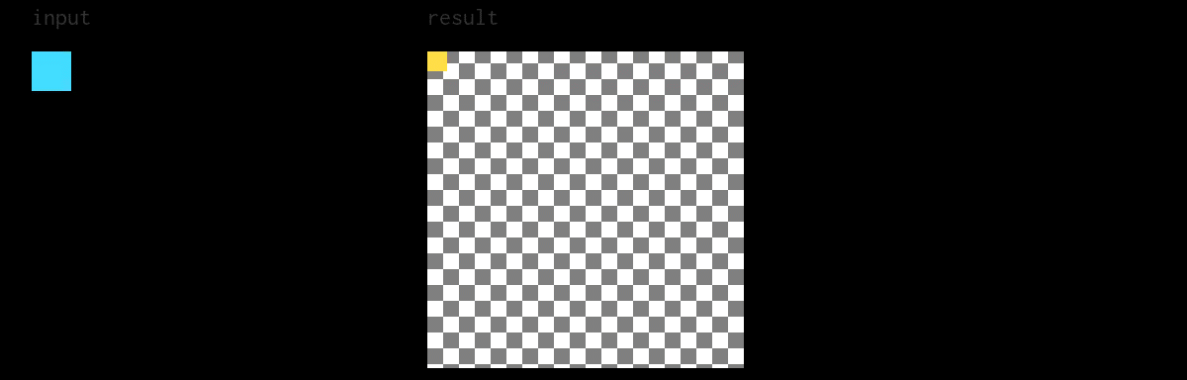
Inline = 7.5ms / 14x
(empty schedule)
for y:
for x:
result(x, y) = ...
Notes:
So if you choose not to schedule your pipeline at all, then every func will be inlined into the result. Because this pipeline is short and memory-bound, this is actually not the worst schedule. It’s ever so slightly faster than the previous one, taking 7.5ms instead of 8ms.
We use inlining as the default schedule in Halide because it encourages users to break down their algorithms into small funcs with zero overhead. This enables scheduling only the funcs that seem relevant up front, but still allows for incremental scheduling without being slow by default (which taking compute_root as the default would be).
Notice that in this schedule, the intermediate buffers for input_16 and blur_x have disappeared completely. Now, nine pixels are read for each pixel of the result, which means considerably more computation than other schedules we’ll examine.

Slide 46
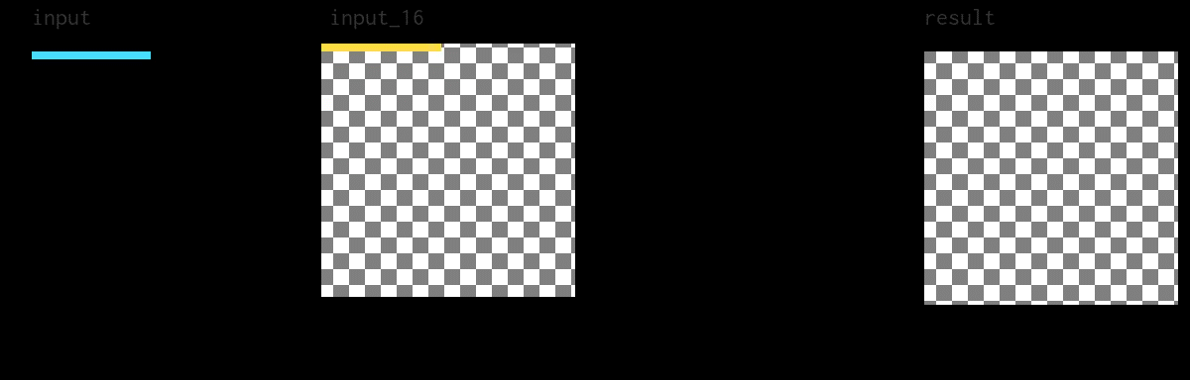
Vector = 3.3ms / 30x
result.compute_root()
allocate input_16; blur_x;
.vectorize(x, 32);
for y:
blur_x.compute_root()
for x:
.vectorize(x, 32);
input_16(x:x+32, y) = ...
input_16.compute_root()
for y:
.vectorize(x, 32);
for x:
blur_x(x:x+32, y) = ...
for y:
for x:
result(x:x+32, y) = ...
Notes:
Halide provides another directive that automatically vectorizes loops for a given vector width, helpfully named “vectorize”. In this case, we mark every inner loop to be vectorized with a 32-element-wide vector. Remember that our funcs operate on uint16’s, which are two bytes wide and AVX-512 has 64-byte wide vector registers. Halide transparently handles alignment and instruction selection issues for every supported architecture.
Notice in the animation that for tail cases, Halide will do some redundant work. When padding and converting the input to the 16-bit form, the vector shifts inwards and overlaps the previous one on each row. This is the same optimization I described at the beginning of the talk, for free. Because these are vector instructions, this is more efficient than switching to serial code for the tail case. The generated assembly has fewer branches and is smaller overall.
This schedule is already pretty good, and it clocks in around 3ms and a 30x boost over the most naïve code we’ve considered. This is the kind of performance you would expect to get if you were using a SIMD template library to optimize the inner loops

Slide 47
Partial
result.compute_root()
allocate input_16; blur_x;
.tile(x, y, xi, yi, 128, 24)
for y:
.vectorize(x, 32);
for x:
blur_x.compute_root()
input_16(x:x+32, y) = ...
.vectorize(x, 32);
for y:
input_16.compute_root()
for x:
.vectorize(x, 32);
blur_x(x:x+32, y) = ...
for y:
for x:
for yi in [0..24]:
for xi in [0..128]:
result(x:x+32, y) = ...
Notes:
But there still aren’t any locality optimizations in that schedule. The first Halide directive we’re going to use to achieve this is called “tile”. It breaks up the “x” and “y” loops into four loops, “x”, “y”, “xi”, and “yi”, where “I” is short for “inner”. Notice in the imperative code that “xi” and “yi” have known extents. Halide will figure out the right bounds for “x” and “y” so that they iterate over the tiles.
Here, I chose to chop up the loops for the result into 128x24 pixel tiles. You might wonder how I picked the tile size. The answer is that I did it by trial and error, which is quick and easy to with Halide. I tried square tiles, tall tiles, and wide tiles, and manually tuned until I landed on this.

Slide 48
Partial
result.compute_root()
allocate input_16; blur_x;
.tile(x, y, xi, yi, 128, 24)
for y:
.vectorize(x, 32);
for x:
blur_x.compute_at(result, x)
input_16(x:x+32, y) = ...
.vectorize(x, 32);
for y:
input_16.compute_root()
for x:
.vectorize(x, 32);
for y:
for x:
blur_x(x:x+32, y) = ...
for yi in [0..24]:
for xi in [0..128]:
result(x:x+32, y) = ...
Notes:
But tiling alone isn’t useful until we fuse the computation of earlier funcs into those tiles.
Halide provides a directive called “compute_at” that enables us to interleave the computations of two funcs by moving the loops for the producing func into the loops of the consuming func. First, we’ll move the “blur_x” func into the “x” loop for the result.

Slide 49
Partial
result.compute_root()
allocate input_16; blur_x;
.tile(x, y, xi, yi, 128, 24)
for y:
.vectorize(x, 32);
for x:
blur_x.compute_at(result, x)
input_16(x:x+32, y) = ...
.vectorize(x, 32);
for result.y:
input_16.compute_root()
for result.x:
.vectorize(x, 32);
for blur_x.y:
for blur_x.x:
blur_x(x:x+32, y) = ...
for yi in [0..24]:
for xi in [0..128]:
result(x:x+32, y) = ...
Notes:
And then qualify the names to avoid clashes. Halide does that automatically. We can see that blur_x… is computed just before the tile loops… for the result, and Halide will use this information to compute only the values of blur_x that are needed for those two innermost loops.

Slide 50
Partial
result.compute_root()
allocate input_16; blur_x;
.tile(x, y, xi, yi, 128, 24)
for result.y:
.vectorize(x, 32);
for result.x:
blur_x.compute_at(result, x)
for y:
.vectorize(x, 32);
for x:
input_16.compute_at(result, x)
input_16(x:x+32, y) = ...
.vectorize(x, 32);
for blur_x.y:
for blur_x.x:
blur_x(x:x+32, y) = ...
for yi in [0..24]:
for xi in [0..128]:
result(x:x+32, y) = ...
Notes:
We then do the same thing with “input_16” and we can see that it moves before the “blur_x” loops.

Slide 51
Partial
result.compute_root()
allocate input_16; blur_x;
.tile(x, y, xi, yi, 128, 24)
for result.y:
.vectorize(x, 32);
for result.x:
blur_x.compute_at(result, x)
for input_16.y:
.vectorize(x, 32);
for input_16.x:
input_16.compute_at(result, x)
input_16(x:x+32, y) = ...
.vectorize(x, 32);
for blur_x.y:
for blur_x.x:
blur_x(x:x+32, y) = ...
for yi in [0..24]:
for xi in [0..128]:
result(x:x+32, y) = ...
Notes:
We disambiguate variable names again and like before only what is needed for the current computation of “blur_x” will be computed in “input_16”.

Slide 52
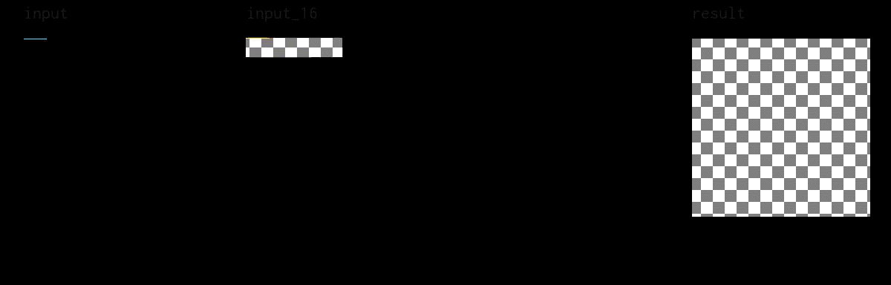
Tiled = 1.2ms / 86x
result.compute_root()
allocate input_16[130 * 26];
.tile(x, y, xi, yi, 128, 24)
allocate blur_x[128 * 26];
.vectorize(x, 32);
for result.y:
blur_x.compute_at(result, x)
for result.x:
.vectorize(x, 32);
for input_16.y:
input_16.compute_at(result, x)
for input_16.x:
.vectorize(x, 32);
input_16(x:x+32, y) = ...
for blur_x.y:
for blur_x.x:
blur_x(x:x+32, y) = ...
for yi in [0..24]:
for xi in [0..128]:
result(x:x+32, y) = ...
Notes:
As a bonus, Halide’s bound inference engine is able to determine that fixed size allocations are suitable for the intermediate buffers because the tile size is fixed. It will malloc them at the start of the pipeline, but because they are constant size, you could ask for them to be placed on the stack with a special directive.
I’ll let this play for a minute. You should notice that the overall pattern of computation resembles the abstracted one we saw earlier on in the talk. Within each tile, we go left to right and top to bottom by vectors and overall, we process tiles in the same way.
This schedule is as fast as I could find for a single core on my workstation CPU. It processes an image in 1.2 milliseconds, or 86 times faster than the worst schedule we saw.

Slide 53
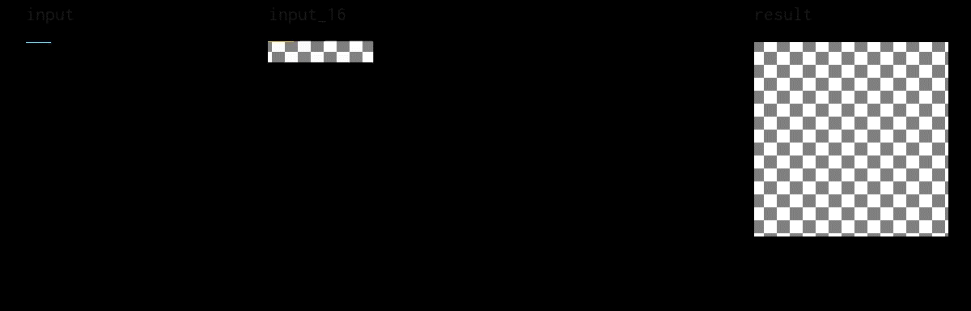
Parallel = 0.4ms / 251x
result.compute_root()
parallel for result.y:
.tile(x, y, xi, yi, 128, 24)
allocate input_16[130 * 26];
.parallel(y)
allocate blur_x[128 * 4];
.vectorize(x, 32);
for result.x:
blur_x.compute_at(result, yi)
for input_16.y:
.store_at(result, x)
for input_16.x:
.vectorize(x, 32);
input_16(x:x+32, y) = ...
input_16.compute_at(result, x)
for yi in [0..24]:
.vectorize(x, 32);
for blur_x.y:
for blur_x.x:
blur_x(x:x+32, y) = ...
for xi in [0..128]:
result(x:x+32, y) = ...
Notes:
Finally, this is the fastest schedule that I could find for four cores. It processes rows of tiles in parallel (remember that result’s “y” indexes tiles)… This is a big optimization.
We also move the “blur_x” computation closer to its usage site… This improves locality at the cost of more compute. This one was a particularly small optimization, but I think it’s due to multiple threads accessing the same memory at the tile boundaries.
Now we can process this image in a mere 0.4ms or 251x faster than what we started with. That’s three whole orders of magnitude.
Notice that this schedules makes use of every optimization we discussed at the beginning of the talk. It uses redundant recomputation both to avoid slow serial code paths and to break dependencies. The independent tiles are computed in parallel and the access patterns within those tiles are cache-friendly. The reason this code runs so fast is because it’s found a sweet spot in the three-way trade off between compute, locality, and parallelism that’s specific to my CPU. It might be the case that a different schedule will be better on your CPU. But this schedule code is only nine lines long. It isn’t a large maintenance burden anymore to write many schedules, each optimized for different hardware.

Slide 54
Automatic scheduling
Mullapudi2016:
Get a decent schedule quickly.
Good for developing the algorithm.
Li2018:
Specialized to gradient descent features (ML)
Supports GPUs / CUDA
Adams2019:
Uses deep learning
Competitive with experts on x86
Notes:
Now, finding these schedules is a bit of an art form and does require some expert knowledge to understand what is fast or slow about a schedule. But a nice feature of having a decoupled scheduling language is that we can define a search space over those schedules and write programs called autoschedulers to go through them automatically. The current release of Halide has three and they’re all named after the academic papers that published the algorithms.
One that’s been around for a while is called Mullapudi 2016 and gives you a decent schedule very quickly. It’s good to use while you’re still developing the algorithm and making sure that it’s correct.
The next one, Li 2018, is optimized for machine learning and optimization tasks where you use Halide’s automatic differentiation features to perform gradient descent. This is a more advanced use case, but it’s currently the only autoscheduler that searches for GPU schedules.
Finally, there’s the Adams 2019 autoscheduler that uses deep learning to produce CPU schedules that are competitive with human experts in x86. There’s ongoing work to bring it to ARM and GPUs, too.

Slide 55
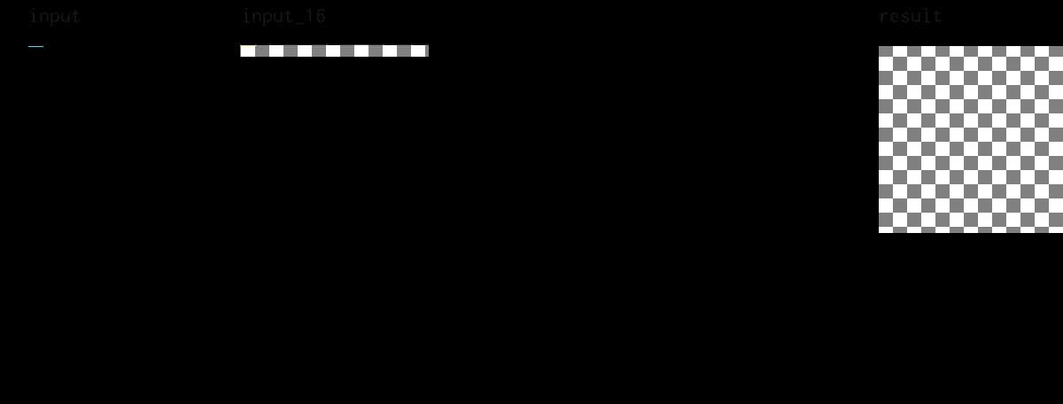
Adams2019 = 0.6ms / 180x
result.tile(x, y, xi, yi, 384, 40) .tile(xi, yi, xii, yii, 96, 20) .tile(xii, yii, x3, y3, 32, 4) .unroll({xii, y3}) .vectorize(x3) .reorder(x3, xii, y3, xi, yii, x, yi, y) .parallel(y);
blur_y.split(x, x, xi, 32) .vectorize(xi, 16) .unroll({xi, y}) .compute_at(result, xi) .reorder(xi, y, x);
blur_x.vectorize(x, 16) .unroll({x, y}) .compute_at(blur_y, x);
input_16.vectorize(x, 32) .compute_at(result, yii) .store_at(result, x);
Can run in a tuning mode where it learns from observing your pipeline
Already competitive on its first attempt
Trade compile time for runtime performance
Notes:
On the blur pipeline, Adams 2019 finds a schedule that runs in 0.6 ms instead of the ever-so-slightly better 0.4 ms schedule we found, but we got it for zero effort.
This isn’t quite fair to the Adams autoscheduler either because this is just the first schedule it returned. It can be run in a tuning or profile-guided mode where it learns by observing your pipeline. This enables you to trade significant compile time for better runtime performance, but it’s already competitive on its first attempt.
Also, I haven’t analyzed this schedule in detail, but I do notice that it uses three levels of tiling, rather than the one that I used earlier. In all likelihood this schedule will beat mine on a larger image because it will optimize the DRAM-to-L3 cache interface better. It also makes use of some more scheduling features than we have time to discuss, like the manual loop unrolling directive, or the store_at directive which enables finer-grained reuse-distance trade-offs.

Slide 56
Question break
Notes:
We’re a bit more than halfway through the talk now, so before we dive into Halide’s implementation, let me pause and answer questions.
[Wait up to 65 seconds for questions to come in]
[READ QUESTIONS OUT LOUD BEFORE YOU ANSWER THEM]
---
[t = 33 min]
[take at least two minutes for questions]

Slide 57
Halide Algorithm
Halide Schedule
Halide IR
LLVM bitcode
X86 (+SSE/AVX)
ARM (+neon)
CUDA
Notes:
Okay, so Halide leans heavily on the LLVM compiler infrastructure, so you can expect all the good research that’s gone into Clang to apply to Halide code as well. We take the Halide algorithm and the schedule, and combine those into a single function in our IR. After some optimization passes, this is translated to LLVM’s IR to compile to vectorized X86 or ARM code, or to graphs of CUDA kernels and the CPU code required to launch and manage them.
---
[t = 35 min]
[slides 57-72 = 15 min – REMEMBER TO PAUSE ON SLIDES WITH CODE]
[Took 11 minutes in rehearsal. Don’t go 1.5x speed]

Slide 58
Halide Algorithm
Halide Schedule
OpenGL Compute
Halide IR
OpenCL
Direct3D 12
LLVM bitcode
Metal
X86 (+SSE/AVX)
ARM (+neon)
CUDA
PowerPC
RISC V
Hexagon/HVX
Notes:
The full picture is a bit messier. We keep adding backends, not all of which go through LLVM. But at this point, if there’s a commercial architecture you can think of, we either support it already, or it would be easy to add support either through a custom backend or by extending LLVM.

Slide 59
Frontend
Build syntax trees using operator overloading and implicit constructors.
All of C++ is constexpr from Halide’s point of view.
Use C++ tools to debug Halide programs.
Notes:
We’ve seen a good bit of the frontend already. The basic way that it works is that we overload operators to simplify the creation of syntax trees for specifying the algorithms. Because Halide code doesn’t run until you schedule it, from the point of view of a Halide algorithm, the whole C++ language is constexpr. For loops in C++ get unrolled into Halide syntax fragments, if statements in C++ let you conditionally include code in the pipeline, etc.
Using C++ as a host language means that we get all the benefits of C++ for debugging Halide programs. This is a good sort of design for a DSL because it avoids the chicken-egg issue of tooling and developer communities. Developers don’t want to use languages without good tools, and no one wants to write tools for a language that no one uses. Staging Halide in C++ means that most of the time I get to work in CLion or Visual Studio and use the fantastic debugging, code completion, and static analysis tools there.

Slide 60
Backend
We translate internal IR to LLVM
Library contains LLVM dependency
LLVM can JIT or emit C-ABI object files
We generate a header for client code
Support for LLVM sanitizers
Notes:
Once you’ve scheduled your pipelines, we translate it to an internal IR which is suitable for bounds inference and then we apply some more domain-specific optimizations before moving on to LLVM. The Halide library contains LLVM inside it so you don’t need to install or deploy it yourself. We then either JIT compile or output an object file and header for future linking. Because we’re using LLVM, Halide pipelines are already compatible with all the popular sanitizers, including thread, memory, and address sanitizers.

Slide 61
JIT mode
We again use LLVM (MCJIT)
Pro: Can define a Halide pipeline in-process, potentially based on user input, then compile and run.
Con: LLVM compilation has high latency.
Notes:
So let’s talk a bit about JIT mode. LLVM has a very robust JIT module called MCJIT that we use. It’s cross platform and well-tested. But JIT mode is mostly useful when the structure of your pipeline might vary at runtime. This is because LLVM’s optimization passes are slow and this introduces a good bit of latency. We have caching mechanism that offset this a bit but if you don’t need dynamic pipelines then the ahead of time mode I’ll discuss in a minute might better suit your needs.

Slide 62
#include <Halide.h>
#include <halide_image_io.h>
#include <iostream>
using namespace Halide;
using namespace Halide::Tools;
int main(int argc, char *argv[]) {
if (argc != 3) {
std::cerr << "Usage: " << argv[0] << " <input> <output>\n";
return 1;
}
Buffer<uint8_t> input = load_and_convert_image(argv[1]);
Var x, y;
Func input_16, blur_x, blur_y, result;
Func clamped = BoundaryConditions::repeat_edge(input);
input_16(x, y) = cast<uint16_t>(clamped(x, y));
blur_x(x, y) = (input_16(x - 1, y) + input_16(x, y) + input_16(x + 1, y)) / 3;
blur_y(x, y) = (blur_x(x, y - 1) + blur_x(x, y) + blur_x(x, y + 1)) / 3;
result(x, y) = cast<uint8_t>(blur_y(x, y));
result.compile_jit();
Buffer<uint8_t> output = result.realize(input.width(), input.height());
convert_and_save_image(output, argv[2]);
return 0;
}
Notes:
So this is a fully working Halide program for the blur we looked at earlier. I left the schedule out to fit it on the slide, but this should give you a sense of just how little code is needed to get something working.
You really do just include a few headers, check your arguments, and get off to the races.
There’s code in here for loading and converting images. Halide supports a wide variety of image formats including PNG, JPEG, TIFF, and even Matlab arrays. Then most of the rest of the code is the same as we saw before.
I’ll give you all a chance to take this in.
---
[PAUSE. Give the audience a good 45-60 seconds to read through this]

Slide 63
#include <Halide.h>
#include <halide_image_io.h>
#include <iostream>
using namespace Halide;
using namespace Halide::Tools;
int main(int argc, char *argv[]) {
if (argc != 3) {
std::cerr << "Usage: " << argv[0] << " <input> <output>\n";
return 1;
}
Buffer<uint8_t> input = load_and_convert_image(argv[1]);
Var x, y;
Func input_16, blur_x, blur_y, result;
Func clamped = BoundaryConditions::repeat_edge(input);
input_16(x, y) = cast<uint16_t>(clamped(x, y));
blur_x(x, y) = (input_16(x - 1, y) + input_16(x, y) + input_16(x + 1, y)) / 3;
blur_y(x, y) = (blur_x(x, y - 1) + blur_x(x, y) + blur_x(x, y + 1)) / 3;
result(x, y) = cast<uint8_t>(blur_y(x, y));
result.compile_jit();
Buffer<uint8_t> output = result.realize(input.width(), input.height());
convert_and_save_image(output, argv[2]);
return 0;
}
Notes:
I did want to call out this bit of code that actually runs the pipeline. First, we call compile_jit to invoke LLVM, but it’s on the second line that we actually run the pipeline. The realize function takes a window of the output to compute. Halide pipelines have a demand-driven execution model. You’ll notice that we don’t explicitly pass the input to the result func, but instead build the whole pipeline around it and then just use its size information to determine what window of the result to compute.

Slide 64
Ahead-of-Time mode
You write a Generator subclass
Compile and run with a special main function (like Google Test)
Link to the generated object and include the generated header.
Generic runner for benchmarking, tests.
Notes:
So if you don’t need to pay the JIT overhead, you can use the ahead of time compilation mode. Conceptually this is more like a traditional compiler invocation, but since Halide is just C++ and has LLVM inside it, you have to do it in two stages. First you write a “Generator” subclass and link to a special main function we provide. This is a fairly similar set-up to Google Test. This gives you a generator binary that you run to get an object file and header. That object file can be linked to your final application, included in a static library, or linked to a generic runner that sniffs metadata about the pipeline to aid in benchmarking and testing.

Slide 65
#include <Halide.h>
using namespace Halide;
struct Blur : public Generator<Blur> {
Input<Buffer<uint8_t>> input{"input", 2};
Output<Buffer<uint8_t>> result{"result", 2};
Var x, y;
Func input_16, blur_x, blur_y;
void generate() {
Func clamped = BoundaryConditions::repeat_edge(input);
input_16(x, y) = cast<uint16_t>(clamped(x, y));
blur_x(x, y) = (input_16(x - 1, y) + input_16(x, y) + input_16(x + 1, y)) / 3;
blur_y(x, y) = (blur_x(x, y - 1) + blur_x(x, y) + blur_x(x, y + 1)) / 3;
result(x, y) = cast<uint8_t>(blur_y(x, y));
}
};
HALIDE_REGISTER_GENERATOR(Blur, blur)
Notes:
The generator code is even shorter because it can exclude the image loading and saving boilerplate that’s provided for us by the generic runner. Again, there’s very little magic here. We have to name the input and output funcs explicitly as fields of the Generator. There’s some C++ template magic going on here that allows the Generator base class to locate those variables. Notice that the struct Blur is passed as a template argument to Generator. This is called the Curiously Recurrent Template Pattern (CRTP for short) and it’s really cool. If you haven’t seen it before, Google it after this talk.
The only other bit of magic here is the HALIDE_REGISTER_GENERATOR macro that communicates the class name and the intended C-ABI function name to the special main function you link against.
---
[PAUSE. Give the audience a good 45-60 seconds to read through this]

Slide 66
Build commands
export HL_TOOLS=$HL_ROOT/share/Halide/tools
$CXX -o GenGen.o -I $HL_ROOT/include -I $HL_TOOLS \ -c $HL_TOOLS/GenGen.cpp
$CXX -o blur.o -I $HL_ROOT/include -I $HL_TOOLS -c blur.cpp
$CXX -o blur_gen blur.o GenGen.o -L $HL_ROOT/lib \ -lHalide -lpthread -ldl
LD_LIBRARY_PATH=$HL_ROOT/lib \ ./blur_gen -g blur -e c_header,object,registration \ -o . target=host
$CXX -o blur.registration.o -I $HL_ROOT/include -I $HL_TOOLS \ -c blur.registration.cpp
$CXX -o RunGenMain.o -I $HL_ROOT/include -I $HL_TOOLS \ -c $HL_TOOLS/RunGenMain.cpp
$CXX -o run_blur blur.registration.o RunGenMain.o blur.o \ $HL_ROOT/lib/libHalide.so -lpng -lz -ljpeg -lpthread -ldl
Notes:
From a build perspective, there’s nothing up our sleeves here, really. You just need to step through and compile the special main and the generator, link them together and to Halide, run that program and then link the resulting registration file to our special runner. These commands are for a GCC-compatible compiler, but the process is essentially the same for MSVC. Imagine that the environment variable HL_ROOT points to the Halide installation path.
---
[PAUSE. Give the audience a good 45-60 seconds to read through this]

Slide 67
Build commands
export HL_TOOLS=$HL_ROOT/share/Halide/tools
$CXX -o GenGen.o -I $HL_ROOT/include -I $HL_TOOLS \ -c $HL_TOOLS/GenGen.cpp
$CXX -o blur.o -I $HL_ROOT/include -I $HL_TOOLS -c blur.cpp
$CXX -o blur_gen blur.o GenGen.o -L $HL_ROOT/lib \ -lHalide -lpthread -ldl
LD_LIBRARY_PATH=$HL_ROOT/lib \ ./blur_gen -g blur -e c_header,object,registration \ -o . target=host
$CXX -o blur.registration.o -I $HL_ROOT/include -I $HL_TOOLS \ -c blur.registration.cpp
$CXX -o RunGenMain.o -I $HL_ROOT/include -I $HL_TOOLS \ -c $HL_TOOLS/RunGenMain.cpp
$CXX -o run_blur blur.registration.o RunGenMain.o blur.o \ $HL_ROOT/lib/libHalide.so -lpng -lz -ljpeg -lpthread -ldl
Notes:
This is the only pain point when it comes to build systems. You need to run a binary you built in order to get a binary you’ll eventually link against. Also, since Halide is a natural cross compiler, we have to specify the target to be the same as the host, but we could also put a different target here. We support cross OS and cross architecture builds. You can compile to ARM from x86 or vice-versa, you can compile to Linux from Windows, too. Your machines don’t need to have CUDA installed or even a GPU to generate CUDA code. And so on.

Slide 68
Not a Cmake talk, but…
cmake_minimum_required(VERSION 3.16) project(aot_example) find_package(Halide REQUIRED) add_executable(blur_gen blur.cpp) target_link_libraries(blur_gen PRIVATE Halide::Generator) add_halide_library(blur FROM blur_gen REGISTRATION blur_reg) add_executable(run_blur ${blur_reg}) target_link_libraries( run_blur PRIVATE Halide::RunGenMain blur)
Notes:
Now this is not a Cmake talk, but if that sounded scary, I really want to put your mind at ease. I’ve personally put a lot of effort into making the build story as seamless as possible. Halide is built with Cmake and we provide a Cmake package, too. Generators are still a bit of a square peg in a round hole for Cmake, but for most common cases, it’s quite easy.

Slide 69
Not a Cmake talk, but…
cmake_minimum_required(VERSION 3.16) project(aot_example) find_package(Halide REQUIRED) add_executable(blur_gen blur.cpp) target_link_libraries(blur_gen PRIVATE Halide::Generator) add_halide_library(blur FROM blur_gen REGISTRATION blur_reg) add_executable(run_blur ${blur_reg}) target_link_libraries( run_blur PRIVATE Halide::RunGenMain blur)
Notes:
All you do is create a generator executable by linking the Halide::Generator target to your sources.

Slide 70
Not a Cmake talk, but…
cmake_minimum_required(VERSION 3.16) project(aot_example) find_package(Halide REQUIRED) add_executable(blur_gen blur.cpp) target_link_libraries(blur_gen PRIVATE Halide::Generator) add_halide_library(blur FROM blur_gen REGISTRATION blur_reg) add_executable(run_blur ${blur_reg}) target_link_libraries( run_blur PRIVATE Halide::RunGenMain blur)
Notes:
Then you call the special add_halide_library function that our package supplies. It will create a static library for you from your generator executable. It has a wide variety of options for more advanced build scenarios, including running an autoscheduler on your pipeline, but this is all you need for standard cases.

Slide 71
Not a Cmake talk, but…
cmake_minimum_required(VERSION 3.16) project(aot_example) find_package(Halide REQUIRED) add_executable(blur_gen blur.cpp) target_link_libraries(blur_gen PRIVATE Halide::Generator) add_halide_library(blur FROM blur_gen REGISTRATION blur_reg) add_executable(run_blur ${blur_reg}) target_link_libraries( run_blur PRIVATE Halide::RunGenMain blur)
Notes:
And then finally, we link the generated blur library to the runner. The add_halide_library function populates a variable with a path to the generated registration code for the runner.

Slide 72
Runtime considerations
Halide has a minimal runtime that is piecemeal replaceable
Dynamic allocation uses system malloc by default but can be replaced.
Highly tuned thread pool faster than TBB
AOT Halide is used in embedded
Notes:
The last bit of Halide’s engineering that I want to talk about is its runtime. Many DSLs have heavy runtime requirements, garbage collectors, and the like. Halide has none of that. It simply requires malloc and a threading implementation.
All the pieces of the runtime can be overridden bit by bit either through weak linking on supported platforms or explicitly calling a function that overwrites a function pointer. The malloc that it uses is the system one by default, but it can be replaced by your own implementation if you so choose. For each operating system we support, we provide a highly tuned thread pool that’s optimized for the types of contention patterns that Halide pipelines encounter. Clients have tried to replace it with, e.g. Intel’s Thread Building Blocks, but so far we haven’t encountered a faster one.
Finally, the runtime is sufficiently minimal that it is used in industry in embedded scenarios. Qualcomm actually provides an older version of Halide as part of their official Hexagon DSP software development kit.
---
https://developer.qualcomm.com/software/hexagon-dsp-sdk/tools

Slide 73
Too long, didn’t listen
Performance is a trade off between parallelism, locality, and redundant recomputation
Performance is counterintuitive and you need to rapidly test many alternatives.
Halide decouples algorithms from schedules
Halide code is easier to maintain and faster than hand-tuned C++ for a fixed development budget
Halide 10.0.0 just released. Try it today!
Notes:
And that about wraps thing up!
I hope you take away these things from my talk. First, performance in numerical pipelines is a complex trade-off between parallelism, locality, and redundant recomputation. Performance is counterintuitive and to achieve maximum performance, you’ll have to try many different strategies, most of which are either pointless or pessimizing.
I also hope you learned about some of the benefits Halide provides. By separating algorithms from their schedules, Halide code is easier to maintain, faster to iterate on, and more portable than manually optimizing C++. Also, we just released Halide 10, which includes the Adams2019 autoscheduler I showed earlier. I hope you give Halide a try!

Slide 74
Questions?
Learn more at https://halide-lang.org
Reach me at alex_reinking@berkeley.edu
LinkedIn: alexreinking
Twitter: alexreinking
Notes:
Thanks so much for listening to my talk. You can learn more at “halide DASH lang.org”, reach me via email at “alex UNDERSCORE reinking@berkeley.edu” or on LinkedIn or Twitter, where my username is just “alexreinking” on both.
I’ll use the remaining time to answer questions but afterwards, I’ll be hanging out in the Hallway track. Ideally on floor 4 table 2, but I’ll post the exact table in the Slack when I get there. Thanks again!
---
[t = 50 min]
[READ QUESTIONS OUT LOUD BEFORE YOU ANSWER THEM]

Slide 75
What about X feature?
Open a PR! ;)
Halide has external functions
Supply bounds equations
Fill a buffer
Do anything.

Slide 76
Why not templates?
Fusion across component boundaries
Very difficult and complex to express a full compiler in the template system.
Offline analysis and tooling
Build times
Notes:
Lots of deficiencies in C++ for these purposes.
- Alias control matters a LOT for Halide.
- There are some proposals for that already, eg n4150
- LLVM IR gives us the controls we need, but restrict isn’t perfect
- C++ gives you a lot of control over performance, until it doesn't, like register allocation
- GP compilers get it wrong for vectorized inner loops a lot of the time
- The register keyword doesn’t do anything, but it should.
- C++ standard doesn't include inlining directives
- “Static” keyword more reliable than “inline”
- These issues rule C++ out for implementing convolutions, which is the most important kernel in ML
http://open-std.org/JTC1/SC22/WG21/docs/papers/2014/n4150.pdf

